Slide 1
Mobile
Listen to music together

Slide 2
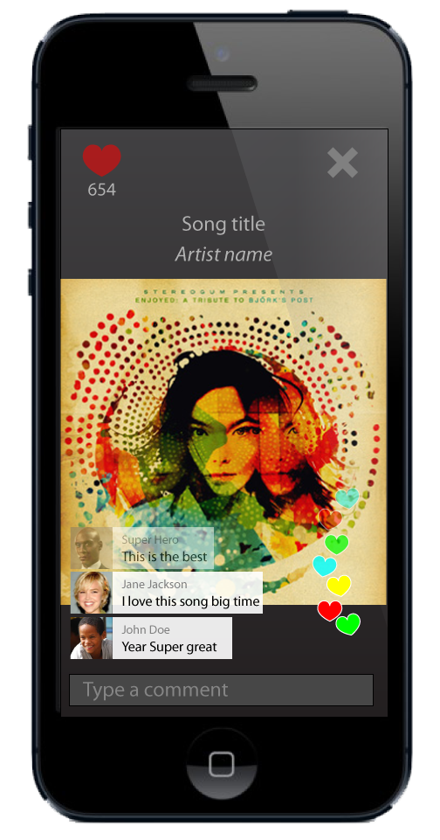
Be together
Applause
Comment
Se when other like it
Listen when they do
Invite other to listen with you
The music sounds better with you. Let me play a great song for you

Slide 3
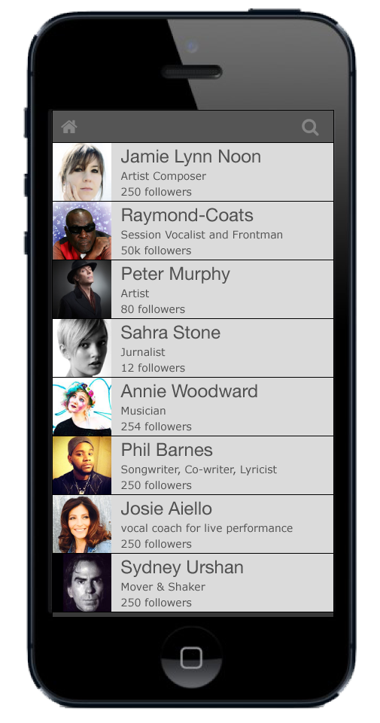
People
Connect with other
Follow DJ’s Artist Curators
Invite friends
Integration with YouTube. Spotify. Facebook

Slide 4
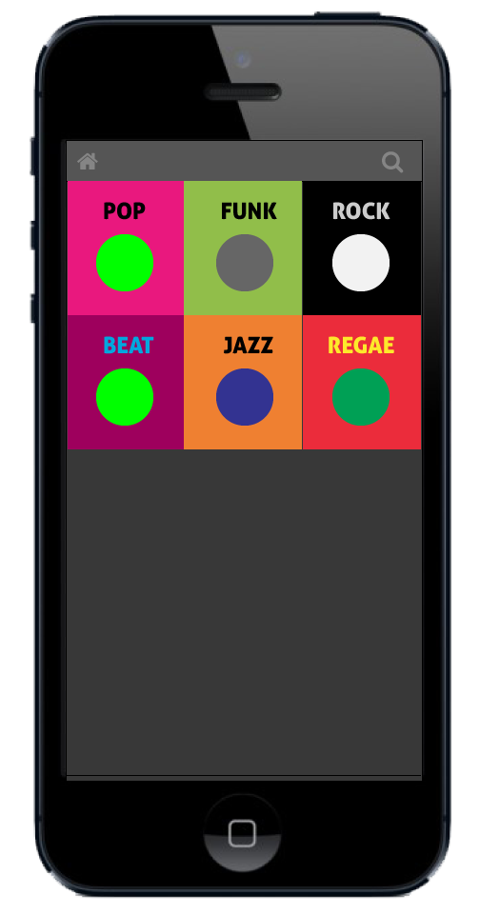
Music
Personal usage
Public usage
Streaming
Playlists
Follow
Content from majors
Pay as you go.
Subscriptions.
Cleared music for public usage.
No PRO involved.
Curated playlists

Slide 5
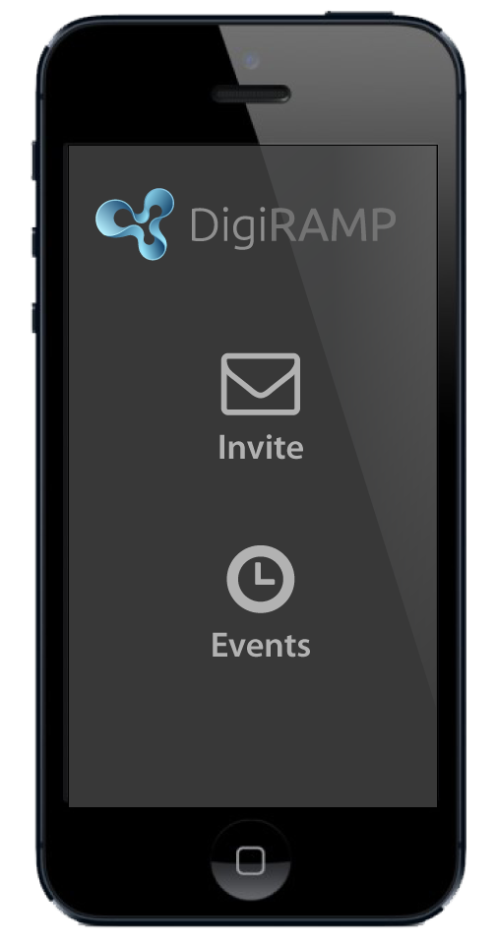
Reach out
Invite to events
Join the party
Stream live music to followers and let them engage while the music is playing
Create events for fans an friends to signup for
Seamless integration.
Real – time push notifications

Slide 6
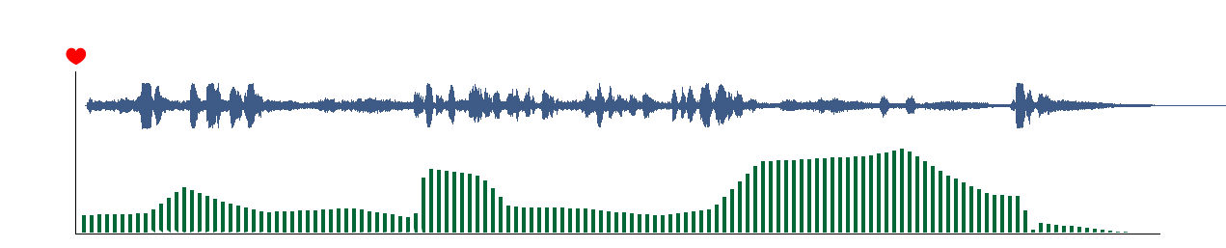
Detailed song metrics
Show what works
Show Demographics
Show Geographic's
High value for playlists

